Slide 1

CAPACITY INVESTMENT DETAIL
800036904 – PROMA JUATUBA

Slide 2



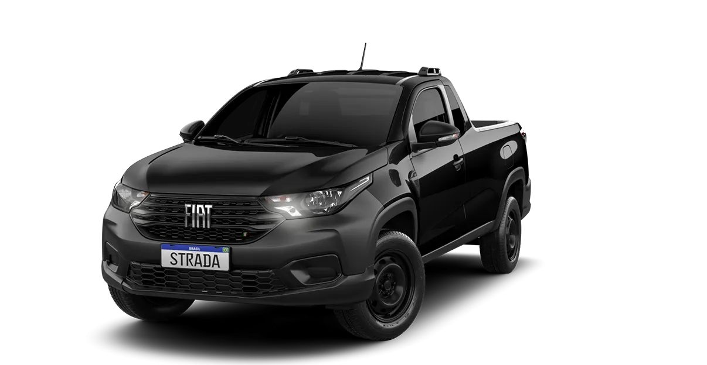
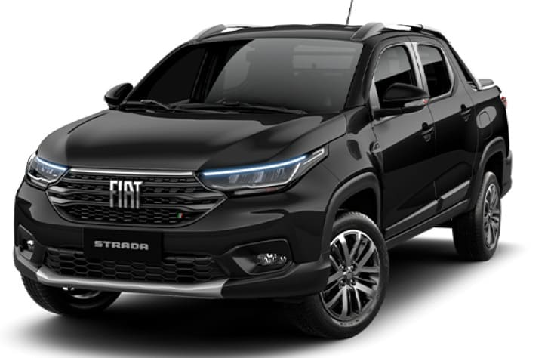

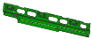





Summary – Supplier Investment Request
PROMA BRASIL AUTOMOTIVA LTDA
800036904
Juatuba-MG
Brasil
03/26/2025
Actual Capacity (Summary)
Proposal Capacity (Summary)
Technical limit of main line SR32 (RIGHT SIDE LONGITUDINAL ASSY. SHORT CABIN 52126456 / LEFT SIDE LONGITUDINAL ASSY. SHORT CABIN 52126468 / RIGHT SIDE CONNECTION REINFORCEMENT ASSY. SHORT CABIN 52126583 / LEFT SIDE CONNECTION REINFORCEMENT ASSY. SHORT CABIN 52126584 / RIGHT SIDE LONGITUDINAL ASSY. LONG CABIN 52126473 / LEFT SIDE LONGITUDINAL ASSY. LONG CABIN 52126474) Producing at its maximum capacity of 37 pieces/hour.
Add 01 robot in the current SR32 welding cell to increase the output from 37 JPH to 46 JPH, aiming to meet the daily volume of 850 JPD, with capacity 966 JPD. It will be necessary to adapt new infrastructure, programming the robot, together with the existing cell.
Hours Per Shift | Shifts per Day | Working Days/Week | Workimg Days/Year | JPH | JPD | JPW | JPY
8 | 3 | 5,5 | 240 | 37 | 778 | 4.279 | 186.720
Hours Per Shift | Shifts per Day | Working Days/Week | Workimg Days/Year | JPH | JPD | JPW | JPY
8 | 3 | 5,5 | 240 | 46 | 966 | 5.313 | 231.840
Investment (R$)
Motivation
Models Impacted
Photo / Drawing (component)
R$ 1.345Mi
(Investment + Taxes)
New Tooling
Retooling
New Ass. Line
Extra Cost
Services
Other
Strada
Lead Time (weeks)
Summary Action Plan
Part Numbers-Descriptions
XX
Short description (in English)
52126456 / 52126468 / 52126583 / 52126584 / 52126473 / 52126474 /
Schedule Activities
Link
Plants Impacted
Impact if Investment Not Approved
Questions
FIASA
FIAPE
FAASA
PALOMAR
PORTO REAL
POWERTRAIN
Daily service limit to a capacity of 777 JPD
Link

Slide 3
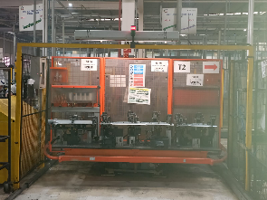
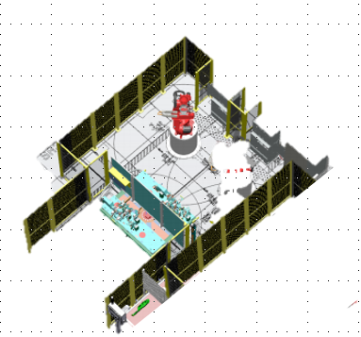
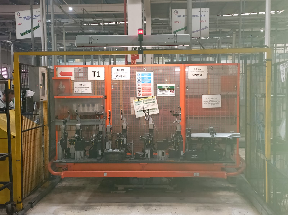
Capacity Detail
PROMA BRASIL AUTOMOTIVA LTDA
800036904
Juatuba-MG
Brasil
03/26/2025
Actual Capacity
Proposal Capacity
SR32
Add new robot in the SR32
Actual Capacity
Proposal Capacity
Technical limit of main line SR32 (RIGHT SIDE LONGITUDINAL ASSY. SHORT CABIN 52126456 / LEFT SIDE LONGITUDINAL ASSY. SHORT CABIN 52126468 / RIGHT SIDE CONNECTION REINFORCEMENT ASSY. SHORT CABIN 52126583 / LEFT SIDE CONNECTION REINFORCEMENT ASSY. SHORT CABIN 52126584 / RIGHT SIDE LONGITUDINAL ASSY. LONG CABIN 52126473 / LEFT SIDE LONGITUDINAL ASSY. LONG CABIN 52126474) Producing at its maximum capacity of 37 pieces/hour.
Add 01 robot in the current SR32 welding cell to increase the output from 37 JPH to 46 JPH, aiming to meet the daily volume of 850 JPD, with capacity 966 JPD. It will be necessary to adapt new infrastructure, programming the robot, together with the existing cell.

Slide 4
Capacity Detail
PROMA BRASIL AUTOMOTIVA LTDA
800036904
Juatuba-MG BRASIL
03/26/2025
Actual Capacity
Proposal Capacity

Slide 5

Financial Summary
PROMA BRASIL AUTOMOTIVA LTDA
800036904
Juatuba-MG BRASIL
03/26/2025
Nº | PN’s | Device/Tooling Description | Qtde. Tooling | Motivation * | CAF ** (Current) | Value (R$) (without taxes) | Taxes |  |  |  | Total (R$) (with taxes) | Investment Responsability
 |  |  |  |  |  |  | ICMS | IPI | PIS/COFINS | ISS
1 | 52126456 / 52126468 / 52126583 / 52126584 / 52126473 / 52126474 | 01 Robo IRB 6700 SW | 1 | TO MEET 850 JPD | TBD | R$ 935.000,00 | 8,8% | - | 9,25% | - | R$ 1.027.055,00 | STELLANTIS
2 |  | INFRAESTRUTURA | 1 |  | TBD | 220.000,00 | 8,8% | - | 9,25% | - | R$ 265.826,00 | STELLANTIS
3 |  | CALIBRE / OUTROS / ETC | 1 |  | TBD | 88.000,00 | 8,8% | - | 9,25% | - | R$ 106.330,40 | STELLANTIS
4
5
6
7
8
9
10
11
12
13
14
15
16
 |  |  |  |  | TOTAL (R$) | R$ 1.158.000,00 |  |  |  | TOTAL (R$) | R$ 1.399.211,40
* New Tooling/Retooling/New Device/New Line/Services/Others
** Inform CAF in the current tooling/Device

Slide 6

Planning
PROMA BRASIL AUTOMOTIVA LTDA
800036904
Juatuba-MG BRASIL
03/26/2025
IN UPDATE

Slide 7
Image (component)
PROMA BRASIL AUTOMOTIVA LTDA
800036904
Juatuba-MG BRASIL
03/26/2025

Slide 8

Impacts/Contingency Plan
PROMA BRASIL AUTOMOTIVA LTDA
800036904
Juatuba-MG BRASIL
03/26/2025
Impacts
Contingency Plan
Currently, SR32 is capable of producing 778 JPD, operating 21 hours per day and 5.5 days per week, totaling 4,279 JPW. To meet the new demand of 1,020 JPD (850 JPD + 20% Mopar and Flexibility), the total required output will be 5,610 JPW, resulting in a shortfall of 242 JPD or 1,331 JPW.
Implement the 6x2 shift system to ensure 7 days of operation per week and adopt staggered meal breaks to maintain 24-hour daily production. With this new Contingency Plan, the output will be 880 JPD and 5,720 JPW, considering 6.5 working days per week, with 0.5 days allocated for maintenance.

Slide 9
Questions
PROMA BRASIL AUTOMOTIVA LTDA
800036904
Juatuba-MG BRASIL
03/26/2025
Questions
Have alternatives been analysed before informing the investment request? Which are? Answer:Yes.
What investments have been or will be made by the supplier to meet the new demand? Answer: Yes
What is the service plan if the lead time required is greater than the time available? Answer: Implement the 6x2 shift system to ensure 7 days of operation per week and adopt staggered meal breaks to maintain 24-hour daily production. With this new Contingency Plan, the output will be 883 JPD and 5,720 JPW, considering 6.5 working days per week, with 0.5 days allocated for maintenance.
What is the service plan until the new capacity is ready? Answer: Implement the 6x2 shift system to ensure 7 days of operation per week and adopt staggered meal breaks to maintain 24-hour daily production. With this new Contingency Plan, the output will be 889 JPD and 5,779 JPW, considering 6.5 working days per week, with 0.5 days allocated for maintenance.
Detail the maximum capacity per PN, without investment. Answer: 778 JPD with 21 hours per day. 4,279 with 5.5 days per week. 889 JPD with 24 hours a day. 4,890 with 5.5 days a week.
Has the investment request been evaluated and validated by the other areas of your company (Engineering / Quality / Manufacturing / SCM, etc.) as the best solution? Answer: Yes

